Slide 1
Artificial Neural Net
By: Samriddh Gupta
McGraw-Hill Machine Learning

Slide 2

Introduction
Artificial Neural Net is best algorithm when it come to leaning a process.
It can be easily explain as the neural in brain and the algorithm tries to duplicate an artificial brain using it.

Slide 3

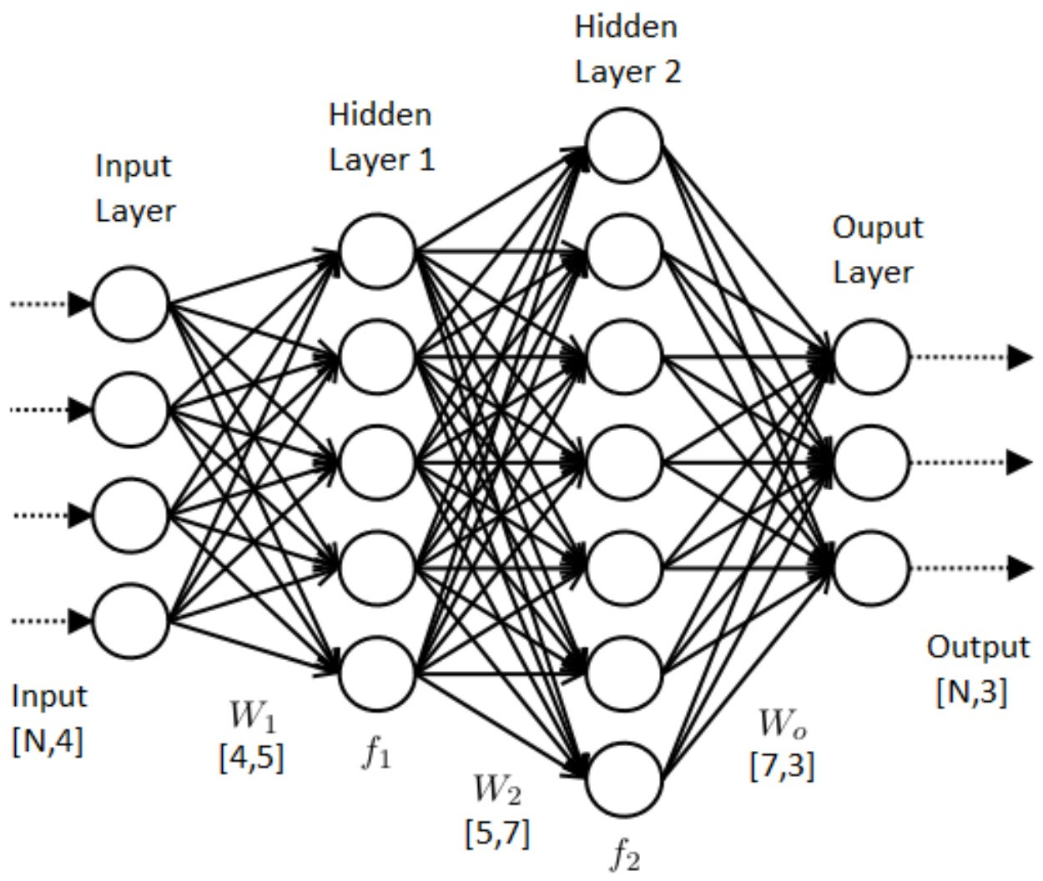
Neural Net Representation
A neural net can be described as interconnected notes with the checkpoints between them.
The check point represent the layers and road represent the interconnected neural which connect each road.
One set of layer can’t be connect in same row and not all of them need to be connected.

Slide 4
Real time application of ANN
Instances are represented by many attribute-value pairs.
The target function output may be discrete-valued, real-valued, or a vector of several real- or discrete-valued attributes.
The training examples may contain errors.
Long training times are acceptable.
Fast evaluation of the learned target function may be required.
The ability of humans to understand the learned target function is not important

Slide 5
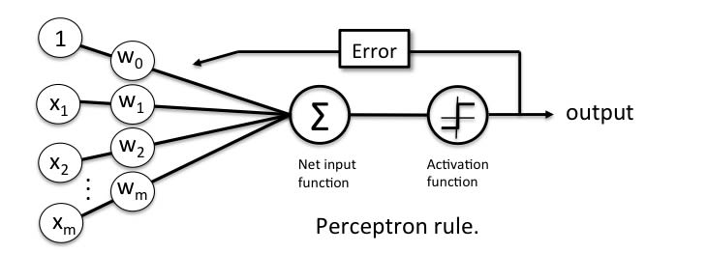
PERCEPTRONS
A Perceptron is an algorithm used for supervised learning of binary classifiers. Binary classifiers decide whether an input, usually represented by a series of vectors, belongs to a specific class.
In short, a perceptron is a single-layer neural network. They consist of four main parts including input values, weights and bias, net sum, and an activation function.

Slide 6
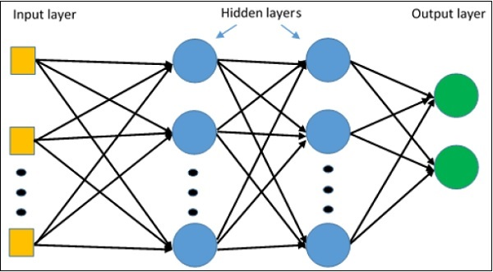
MULTILAYER NETWORKS and backpropagation
A single layer might gives you a linear function but we can also use multiple layers so that we can also deal with function which are NOT linear.
They can have different function working on them which are helpful as not everything in the real word follows a pattern.
This also help in backpropagating on the problem and change the necessary weights which could help us increase the accuracy.

Slide 7
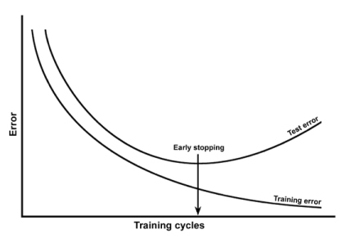
Generalization, Overfitting, and Stopping Criterion
The overfitting problem can be solved by putting a validation data in the algorithms.
The overfitting could also be solved if in the training data, error falls below some level.
The large degree of weights could be used for generalization of the data.
Stopping criteria can be simple can stop whenever the error is the lowest for the data.

